Slide 1

Clustering
Note to other teachers and users of these slides: We would be delighted if you found this our material useful in giving your own lectures. Feel free to use these slides verbatim, or to modify them to fit your own needs. If you make use of a significant portion of these slides in your own lecture, please include this message, or a link to our web site: http://www.mmds.org
Mining of Massive Datasets
Jure Leskovec, Anand Rajaraman, Jeff Ullman Stanford University
http://www.mmds.org

Slide 2
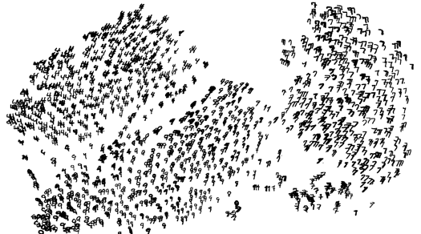
High Dimensional Data
Given a cloud of data points we want to understand its structure

Slide 3
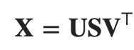
The Problem of Clustering
Given a set of points, with a notion of distance between points, group the points into some number of clusters, so that
Members of a cluster are close/similar to each other
Members of different clusters are dissimilar
Usually:
Points are in a high-dimensional space
Similarity is defined using a distance measure
Euclidean, Cosine, Jaccard, edit distance, …

Slide 4
Example: Clusters & Outliers
x
xx x
x x
x x x
x
x x x
x
x
xx x
x x
x x x
x
x x x
x
x
x x
x x x x
x x x x
x x x
x x
x x
x x x x
x x x x
x x x
x x
x x
x x x x
x x x
x
x x
x x x x
x x x
x
x
Outlier
Cluster

Slide 5
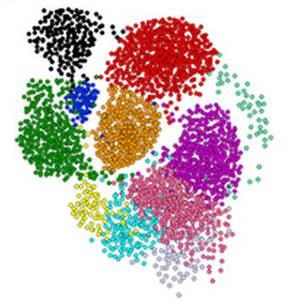
Clustering is a hard problem!

Slide 6
Why is it hard?
Clustering in two dimensions looks easy
Clustering small amounts of data looks easy
Many applications involve not 2, but 10 or 10,000 dimensions
High-dimensional spaces look different: Almost all pairs of points are at about the same distance

Slide 7
High Dimension: Euclidean
Consider a set of data points on a line
dist(a, b) < dist(a, c)
Consider increasing the dimension by 1
dist(a, b) ~ dist(a, c)
a
b
c
b
a
c

Slide 8
High Dimension: Cosine
Cosine(a, b) > Cosine(a, c)
Increase d to 3
Cosine(a, b) ~ Cosine(a, c)
Higher d
Angle -> 90º
Cosine -> 0
b
a
c
a
b
c

Slide 9
Curse of Dimensionality
Data points have similar distance btw each other
Euclidean distance breaks
almost all pairs of points are equally far away from one another
Data vectors become orthogonal
Cosine function breaks
almost any two vectors are orthogonal
https://bigsnarf.wordpress.com/2013/06/14/curse-of-dimensionality/

Slide 10
Clustering Problem: Music CDs
Intuitively: Music divides into categories, and customers prefer a few categories
But what are categories really?
Represent a CD by a set of customers who bought it:
Similar CDs have similar sets of customers, and vice-versa

Slide 11
Clustering Problem: Music CDs
Space of all CDs:
Think of a space with one dim. for each customer
Values in a dimension may be 0 or 1 only
A CD is a point in this space (x₁, x₂,…, x_{k}), where x_{i} = 1 iff the i ^{th} customer bought the CD
For Amazon, the dimension is tens of millions
Task: Find clusters of similar CDs

Slide 12
Cosine, Jaccard, and Euclidean
As with CDs we have a choice when we think of documents as sets of words or shingles:
as vectors: Measure similarity by the cosine distance
as sets: Measure similarity by the Jaccard distance
as points: Measure similarity by Euclidean distance

Slide 13
Measure similarity
Euclidean distance
cosine distance
Jaccard distance
cosine distance

Slide 14
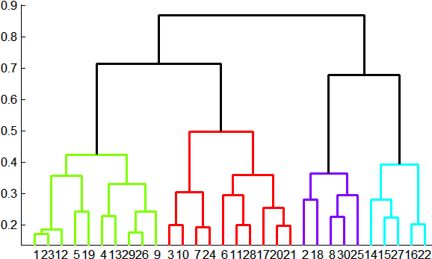
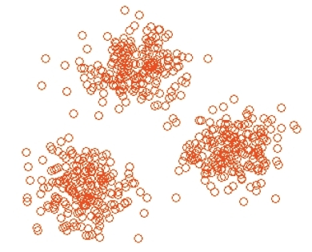
Overview: Methods of Clustering
Hierarchical:
Agglomerative (bottom up):
Initially, each point is a cluster
Repeatedly combine the two “nearest” clusters into one
Divisive (top down):
Start with one cluster and recursively split it
Point assignment:
Maintain a set of clusters
Points belong to “nearest” cluster

Slide 15
Hierarchical Clustering
Key operation: Repeatedly combine two nearest clusters
Three important questions:
1) How do you represent a cluster of more than one point?
2) How do you determine the “nearness” of clusters?
3) When to stop combining clusters?

Slide 16
Hierarchical Clustering
Key operation: Repeatedly combine two nearest clusters
(1) How to represent a cluster of many points?
Euclidean case: each cluster has a centroid = average of its (data)points
(2) How to determine “nearness” of clusters?
Measure cluster distances by distances of centroids

Slide 17
Example: Hierarchical clustering
(5,3)
o
(1,2)
o
o (2,1) o (4,1)
o (0,0) o (5,0)
x (1.5,1.5)
x (4.7,1.3)
x (1,1)
x (4.5,0.5)
Data:
o … data point
x … centroid
Dendrogram

Slide 18
And in the Non-Euclidean Case?
What about the Non-Euclidean case?
The only “locations” we can talk about are the points themselves
i.e., there is no “average” of two points
Approach 1:
(1) How to represent a cluster of many points? clustroid = (data)point “closest” to other points
(2) How do you determine the “nearness” of clusters? Treat clustroid as if it were centroid, when computing inter-cluster distances

Slide 19
“Closest” Point?
(1) How to represent a cluster of many points? clustroid = point “closest” to other points
Possible meanings of “closest”:
Smallest maximum distance to other points
Smallest average distance to other points
Smallest sum of squares of distances to other points
For distance metric d clustroid c of cluster C is:
Datapoint
Centroid
X
Centroid is the avg. of all (data)points in the cluster. This means centroid is an “artificial” point.
Clustroid is an existing (data)point that is “closest” to all other points in the cluster.
Clustroid
Cluster on 3 datapoints

Slide 20
Defining “Nearness” of Clusters
(2) How do you determine the “nearness” of clusters?
Approach 2: Intercluster distance = minimum of the distances between any two points, one from each cluster
Approach 3: Pick a notion of “cohesion” of clusters, e.g., maximum distance from the clustroid
Merge clusters whose union is most cohesive

Slide 21
Cohesion
Approach 3.1: Use the diameter of the merged cluster = maximum distance between points in the cluster
Approach 3.2: Use the average distance between points in the cluster
Approach 3.3: Use a density-based approach
Take the diameter or avg. distance, e.g., and divide by the number of points in the cluster

Slide 22
Example
Consider a cluster of 4 points:
abcd, aecdb, abecb, ecdab
Their edit distances:
Insertion
Deletion
Substitution
 | aecdb | abecb | ecdab
abcd | 3 | 3 | 5
aecdb |  | 2 | 2
abecb |  |  | 4
Notes:
Insertion of a single symbol. If a = uv, then inserting the symbol x produces uxv. This can also be denoted ε→x, using ε to denote the empty string.Deletion of a single symbol changes uxv to uv (x→ε).Substitution of a single symbol x for a symbol y ≠ x changes uxv to uyv (x→y).

Slide 23
Determine Clusteroid
aecdb will be chosen as clusteroid
Located in “center” judged by all 3 measures
Point | Sum | Sum-sq | Max
abcd | 11 | 43 | 5
aecdb | 7 | 17 | 3
abecb | 9 | 29 | 4
ecdab | 11 | 45 | 5
 | aecdb | abecb | ecdab
abcd | 3 | 3 | 5
aecdb |  | 2 | 2
abecb |  |  | 4

Slide 24
Complexity of Hierarchical Clustering
n data points
At most n – 1 step of merging
Naive implementation, e.g., storing pairwise cluster distances in a matrix
 | C1 | C2 | C3 | C4
C1 | 0 | 2 | 3 | 2
C2 |  | 0 | 4 | 5
C3 |  |  | 0 | 3
C4 |  |  |  | 0

Slide 25
Complexity of Naive Implementation
Initially, O(n²) for creating matrix and finding pair with minimum distance
Subsequent merge, assuming matrix: k x k
Delete columns for old clusters: O(k)
Add new column for new cluster C’: O(k)
Compute dist. of C’ with other clusters: O(k)
Find new pair of clusters with min. dist: O(k²)
=> Overall complexity: O(n³)
Notes:
N, n-1, n-2,…k,…1 so n*k^2 = n^3

Slide 26
Implementation Summary
Naïve implementation of hierarchical clustering:
At each step, compute pairwise distances between all pairs of clusters, then merge
O(N³)
Careful implementation using priority queue can reduce time to O(N² log N) (read textbook)
Still too expensive for really big datasets that do not fit in memory

Slide 27
k-means clustering

Slide 28
k–means Algorithm(s)
Assumes Euclidean space/distance
Start by picking k, the number of clusters
Initialize clusters by picking one point per cluster
Example: Pick one point at random, then k-1 other points, each as far away as possible from the previous points

Slide 29
Example: Assigning Clusters
x
x
x
x
x
x
x
x
x
x
x
x … data point
… centroid
Clusters after round 1

Slide 30
Example: Assigning Clusters
x
x
x
x
x
x
x
x
x
x
x
x … data point
… centroid
Clusters after round 2

Slide 31
Example: Assigning Clusters
x
x
x
x
x
x
x
x
x
x
x
x … data point
… centroid
Clusters at the end

Slide 32
Populating Clusters
1) For each point, place it in the cluster whose current centroid it is nearest
2) After all points are assigned, update the locations of centroids of the k clusters
3) Reassign all points to their closest centroid
Sometimes moves points between clusters
Repeat 2 and 3 until convergence
Convergence: Points don’t move between clusters and centroids stabilize

Slide 33
Getting the k right
How to select k?
Try different k, looking at the change in the average distance to centroid as k increases
Average falls rapidly until right k, then changes little
Best value
of k
Average
distance to
centroid
k

Slide 34
Example: Picking k
x
xx x
x x
x x x
x
x x x
x
Too few;
many long
distances
to centroid.
x
x x
x x x x
x x x x
x x x
x x
x x
x x x x
x x x
x
x

Slide 35
Example: Picking k
x
xx x
x x
x x x
x
x x x
x
x
Just right;
distances
rather short.
x x
x x x x
x x x x
x x x
x x
x x
x x x x
x x x
x
x

Slide 36
Example: Picking k
Too many;
little improvement
in average
distance.
x
xx x
x x
x x x
x
x x x
x
x
x x
x x x x
x x x x
x x x
x x
x x
x x x x
x x x
x
x

Slide 37
Summary
Clustering: Given a set of points, with a notion of distance between points, group the points into some number of clusters
Algorithms:
Agglomerative hierarchical clustering:
Centroid and clustroid
k-means:
Initialization, picking k

